Slide 1
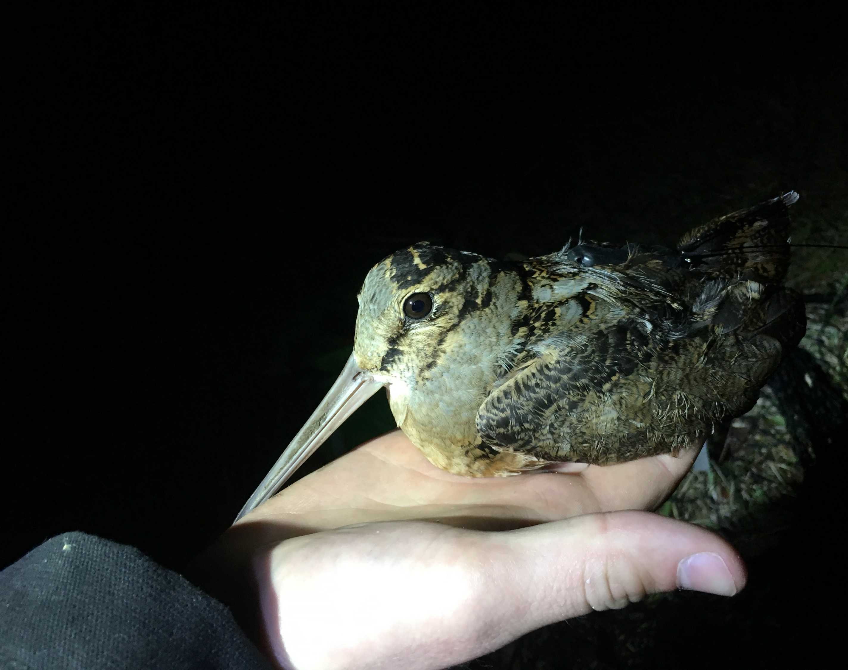
Woodcock Habitat Modeling
Second quarterly update, 2/1/2021
Liam Berigan

Slide 2
Review of overall goals
Two models:
Migratory model: focused on statewide layers
Residential model: all statewide layers, but with additional state game land layers
Anticipated use for the product is to determine which state lands could host woodcock stopover habitat given appropriate management

Slide 3
Review of proposed timeline
November 2020
Assemble habitat layers for the migratory model
January 2021
Have a draft product assembled for the migratory model
April 2021
Have a draft product assembled for the residential model
July 2021
All final products prepared

Slide 4
Modeling strategy
Build migratory corridor models to simulate availability of stopover habitat
Trial several modeling strategies, pick the one with the highest predictive capacity
Evaluate variable performance through jackknifing
Create a predictive surface using the best model

Slide 5
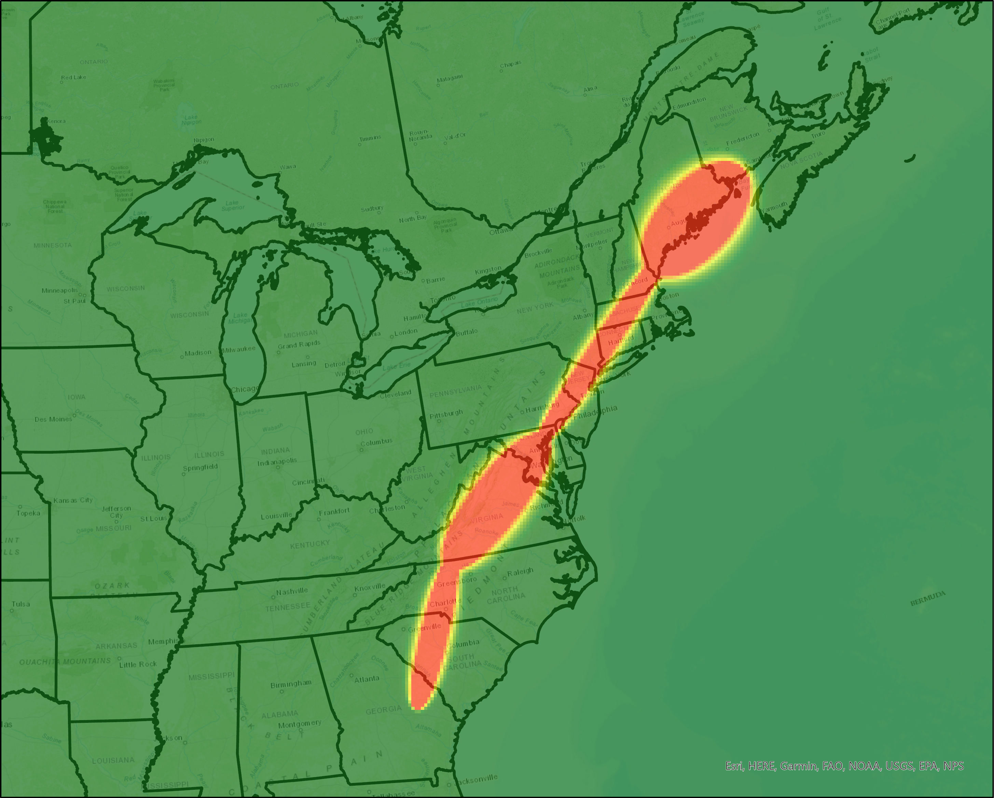
Migratory corridor model building
Separate migratory locations for spring and fall
Simplify to only a single location per stopover
Interpolate a “spaghetti model” of possible flight trajectories for each individual using Brownian Bridge Movement Models

Slide 6
Migratory corridor model building
Combine the trajectories using two methods
Unweighted: equal weight for each trajectory
Weighted: multiply by the population of the state the bird spent the breeding season in, and divides by the number of other birds that spent the breeding season in that state

Slide 7
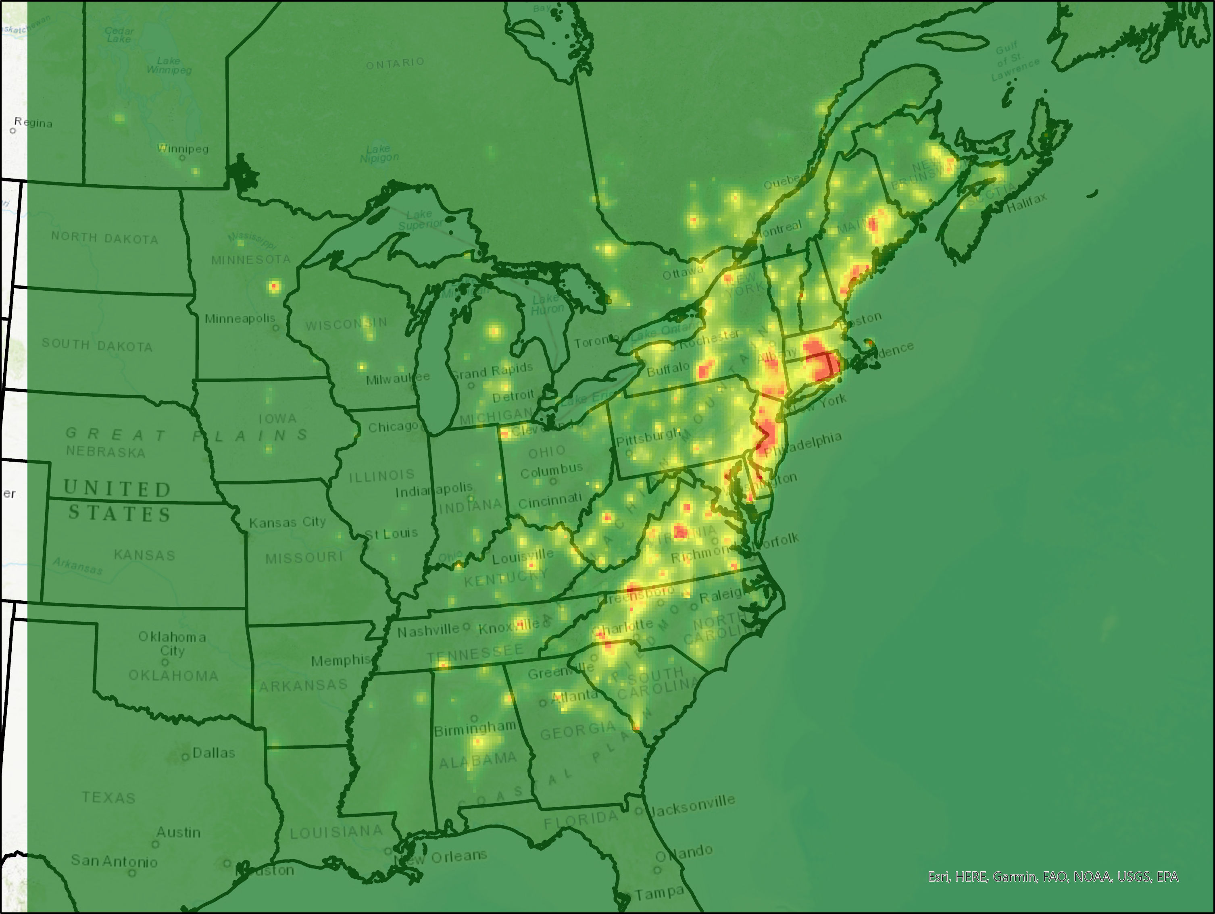
Notes:
Unweighted spring corridor map
Only displaying the spring migratory corridors here; because spring migration is a lot slower and we record more stopovers we end up with a much more detailed picture of woodcock migration routes. We can potentially find ways to use both later on if that’s of interest
Most woodcock migration in PA passes through the eastern portion of the state
Heavily weighted towards Rhode Island due to the large numbers of birds being released there, which was one motivation for the weighted stopover map

Slide 8
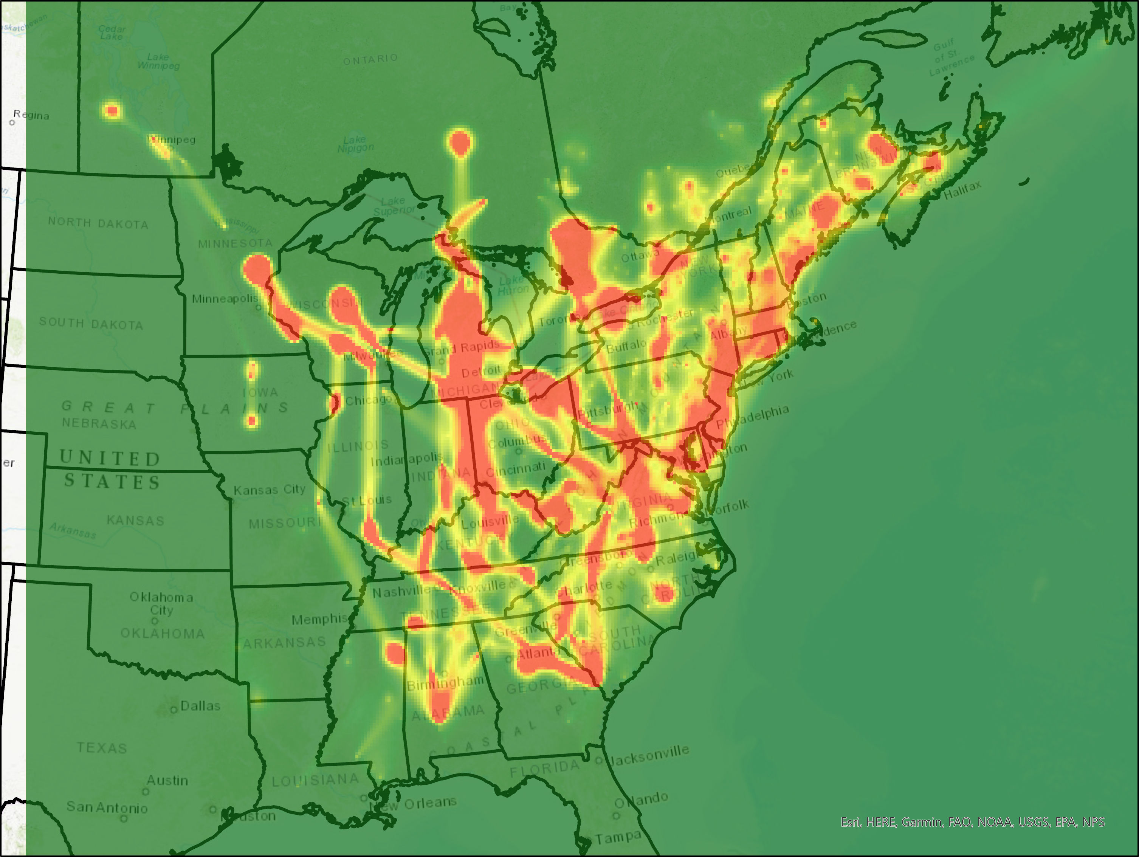
Notes:
Weighted spring corridor map
Much more realistic estimate of corridors in new England, but midwestern paths are being weighted far too heavily
Couple options to fix this; primarily considering weighting by the number of birds transmittered in the capture state instead of the breeding state (e.g. GA instead of MN)
Patterns in PA are similar; lots of birds moving along the eastern edge of the state.
Additionally, we see a lot more movement through the southwest
Because the weighted map is still in progress, we used the unweighted map for the analyses that we show next

Slide 9
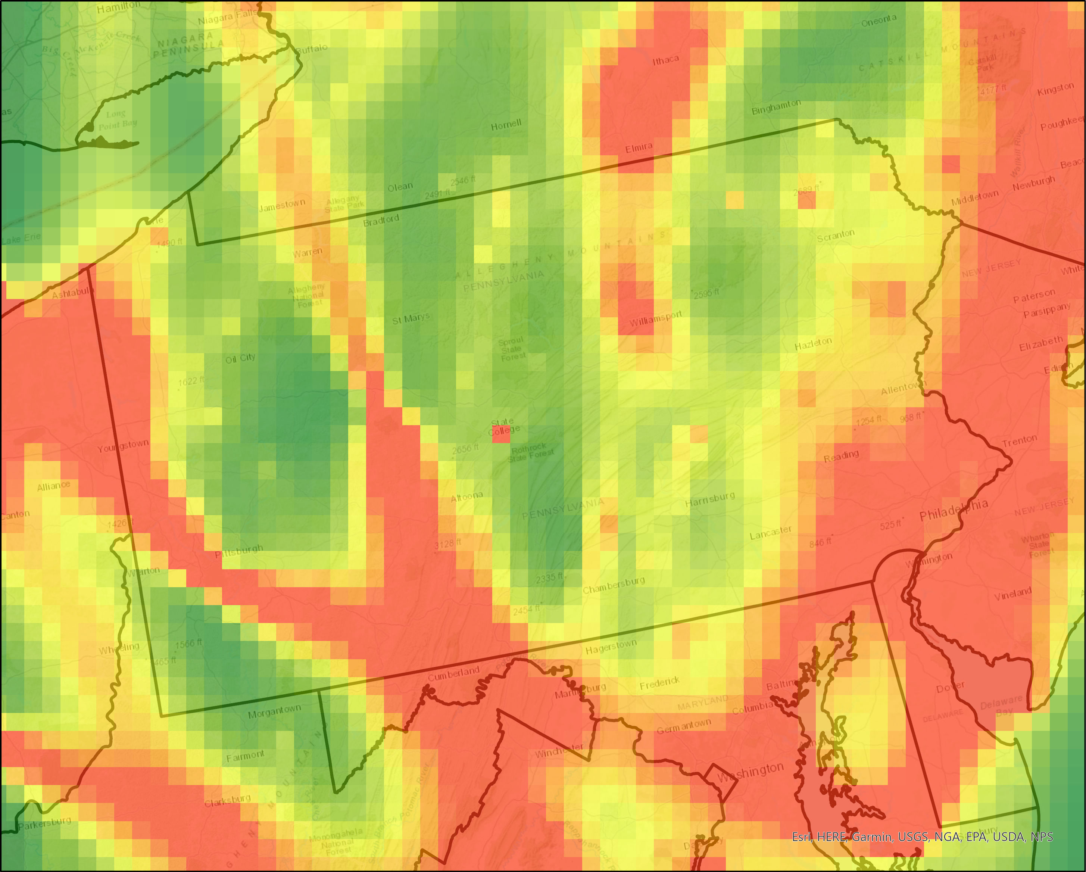
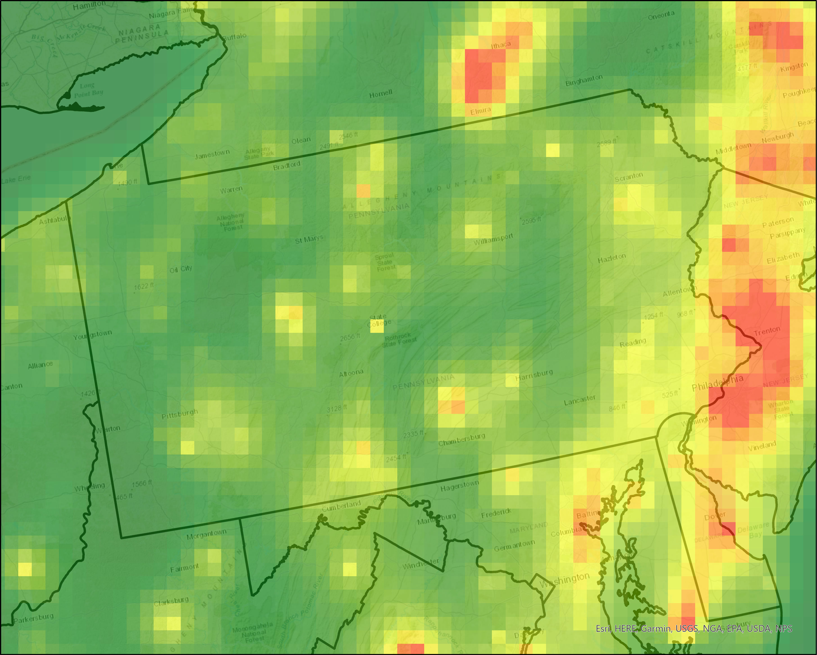
Weighted
Unweighted

Slide 10
Modeling strategy
Build migratory corridor models to simulate availability of stopover habitat
Trial several modeling strategies, pick the one with the highest predictive capacity
Evaluate variable performance through jackknifing
Create a predictive surface using the best model

Slide 11
Evaluating stopover models
AUC is:
A method for evaluating the accuracy of a predictive model
The probability of correctly ranking a used/available pair
0.0 AUC
Always wrong
0.5 AUC
“Coin flip”
1.0 AUC
Always right
0.6 – 0.75
Good model
0.75 – 0.95
Excellent model

Slide 12
Model selection
Each model was run once with availability determined by migratory corridors and once with availability spread evenly throughout the state
Comparison of model performance and availability metrics via AUC
 | Availability w/ corridors | Availability w/o corridors
MaxEnt | 0.68 | 0.66
Random Forest | 0.70 | 0.69
Boosted Regression Trees | 0.63 | 0.61

Slide 13
Modeling strategy
Build migratory corridor models to simulate availability of stopover habitat
Trial several modeling strategies, pick the one with the highest predictive capacity
Evaluate variable performance through jackknifing
Create a predictive surface using the best model

Slide 14
Predictive Variables
Landscape* | Moisture* | Land cover | Topography
Aggregation index (5k) | Soil drainage class | Forest | Elevation
Cohesion (5k) | Topographic wetness index |  | Slope
Percent of landcover as forest (5k)

Slide 15
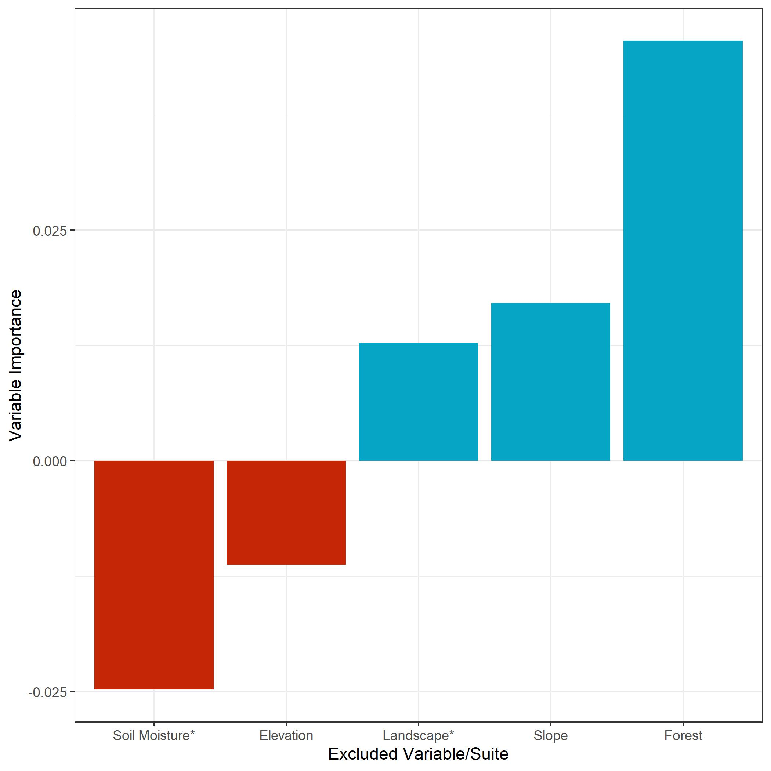
Notes:
Variable importance is measured as the reduction in AUC when the variable/suite is removed from the full model (jacknifing).
Simple version: Variables with positive values improve our predictive capacity, and variables with negative values detract from it
Asterisk indicates a suite of highly correlated variables
Will continue to evaluate the contributions of Soil Moisture* and Elevation as I improve the model and remove them if values are still negative

Slide 16
Landscape metrics

Slide 17
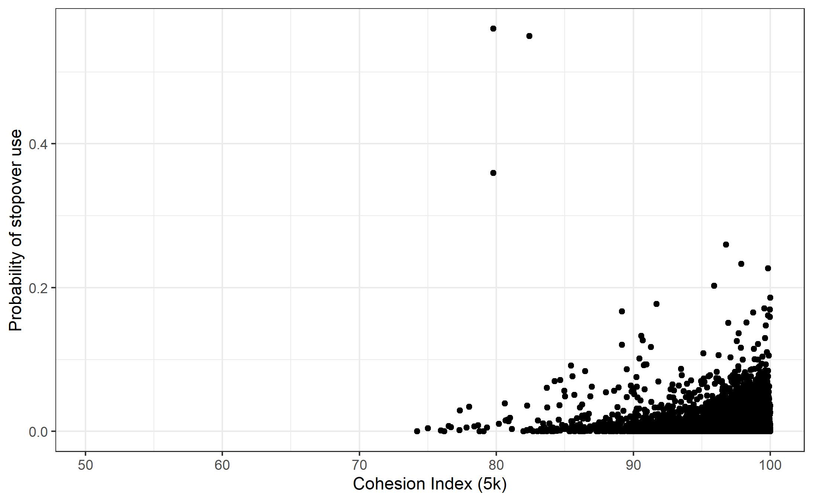
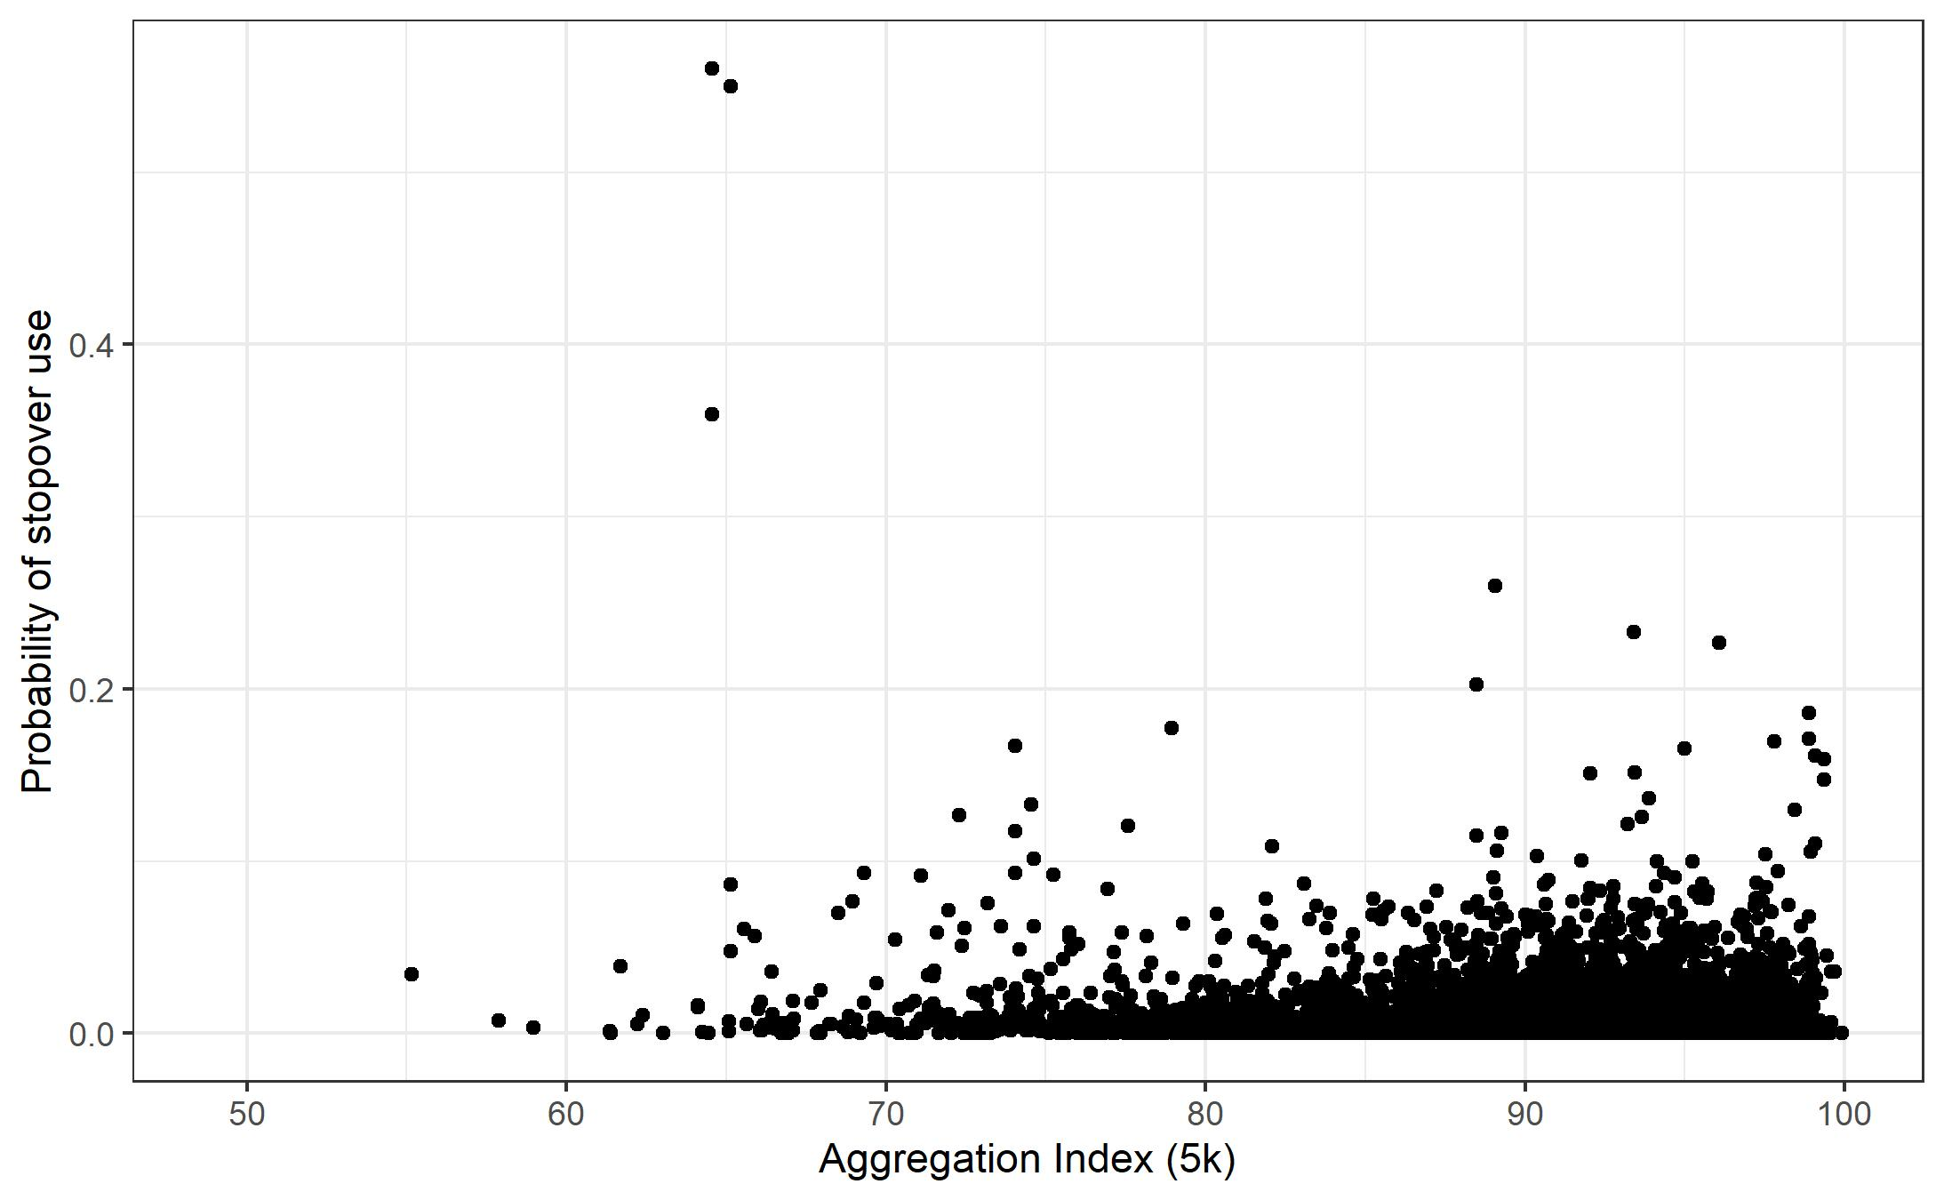
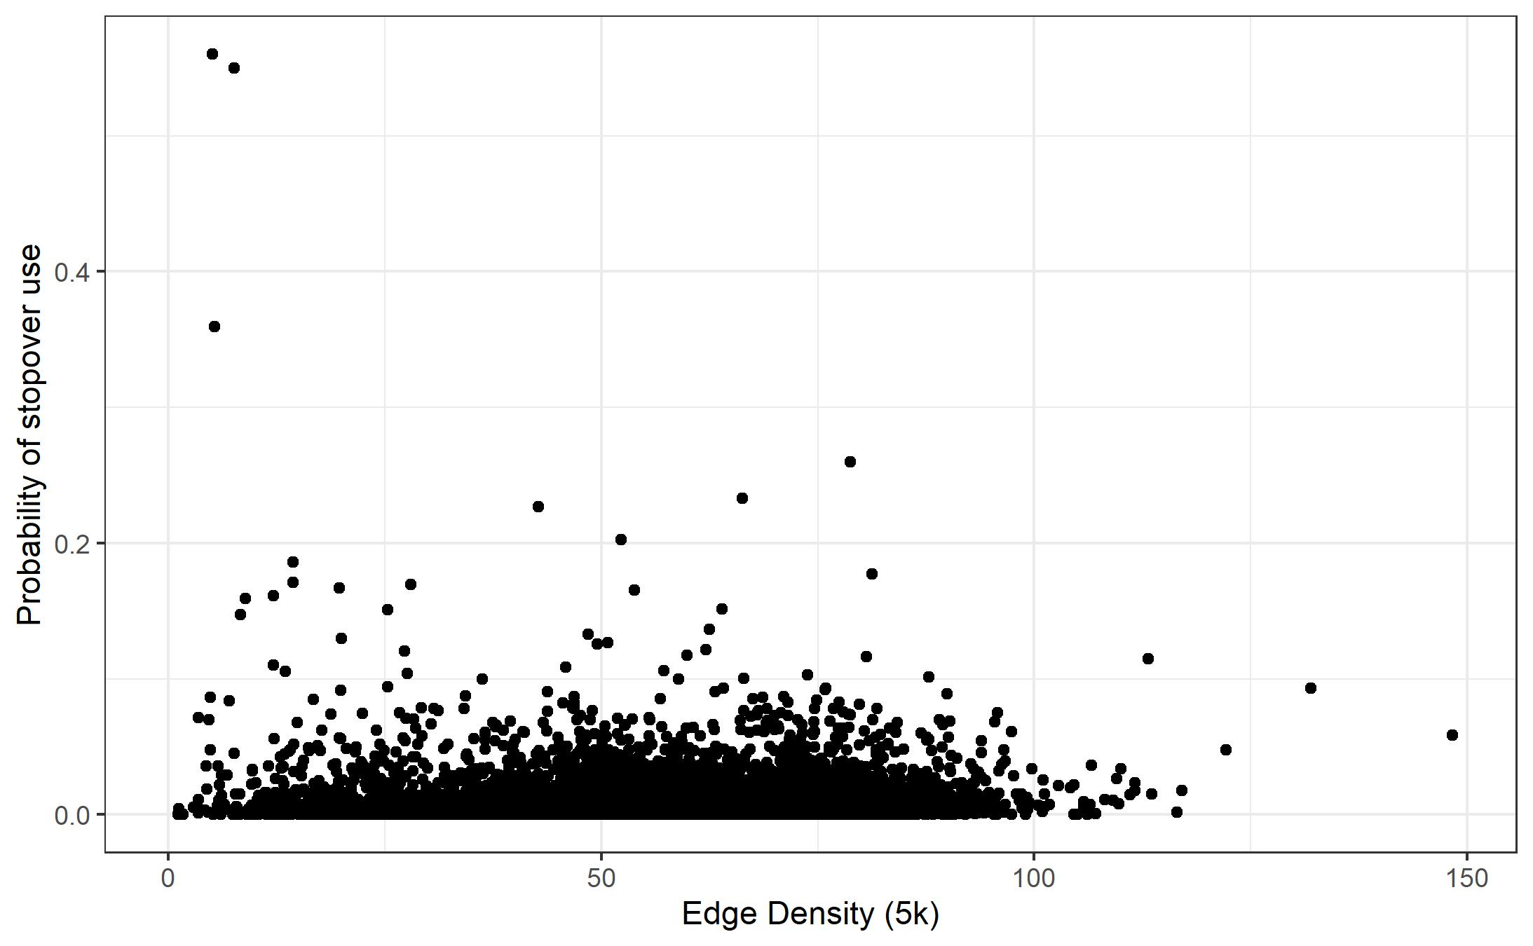
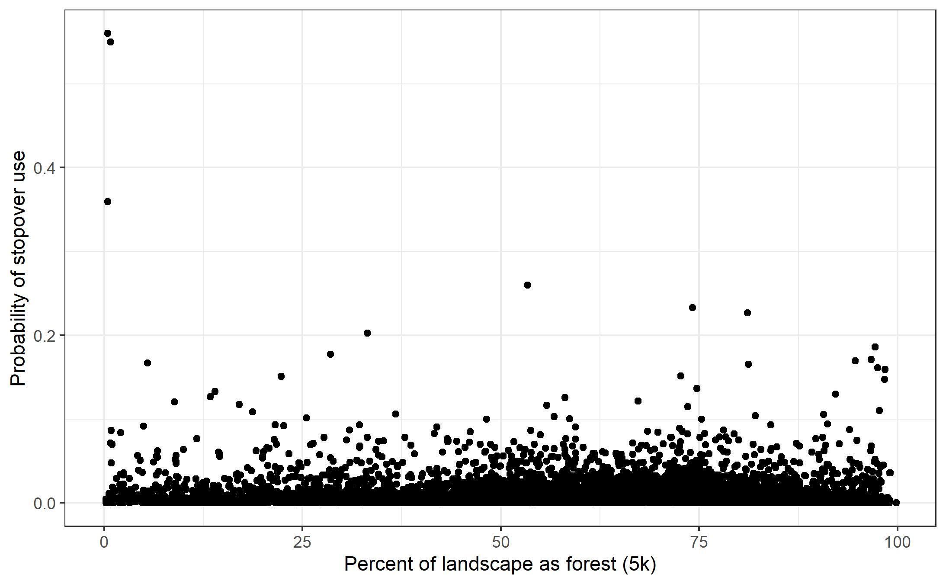

Slide 18
Moisture metrics

Slide 19
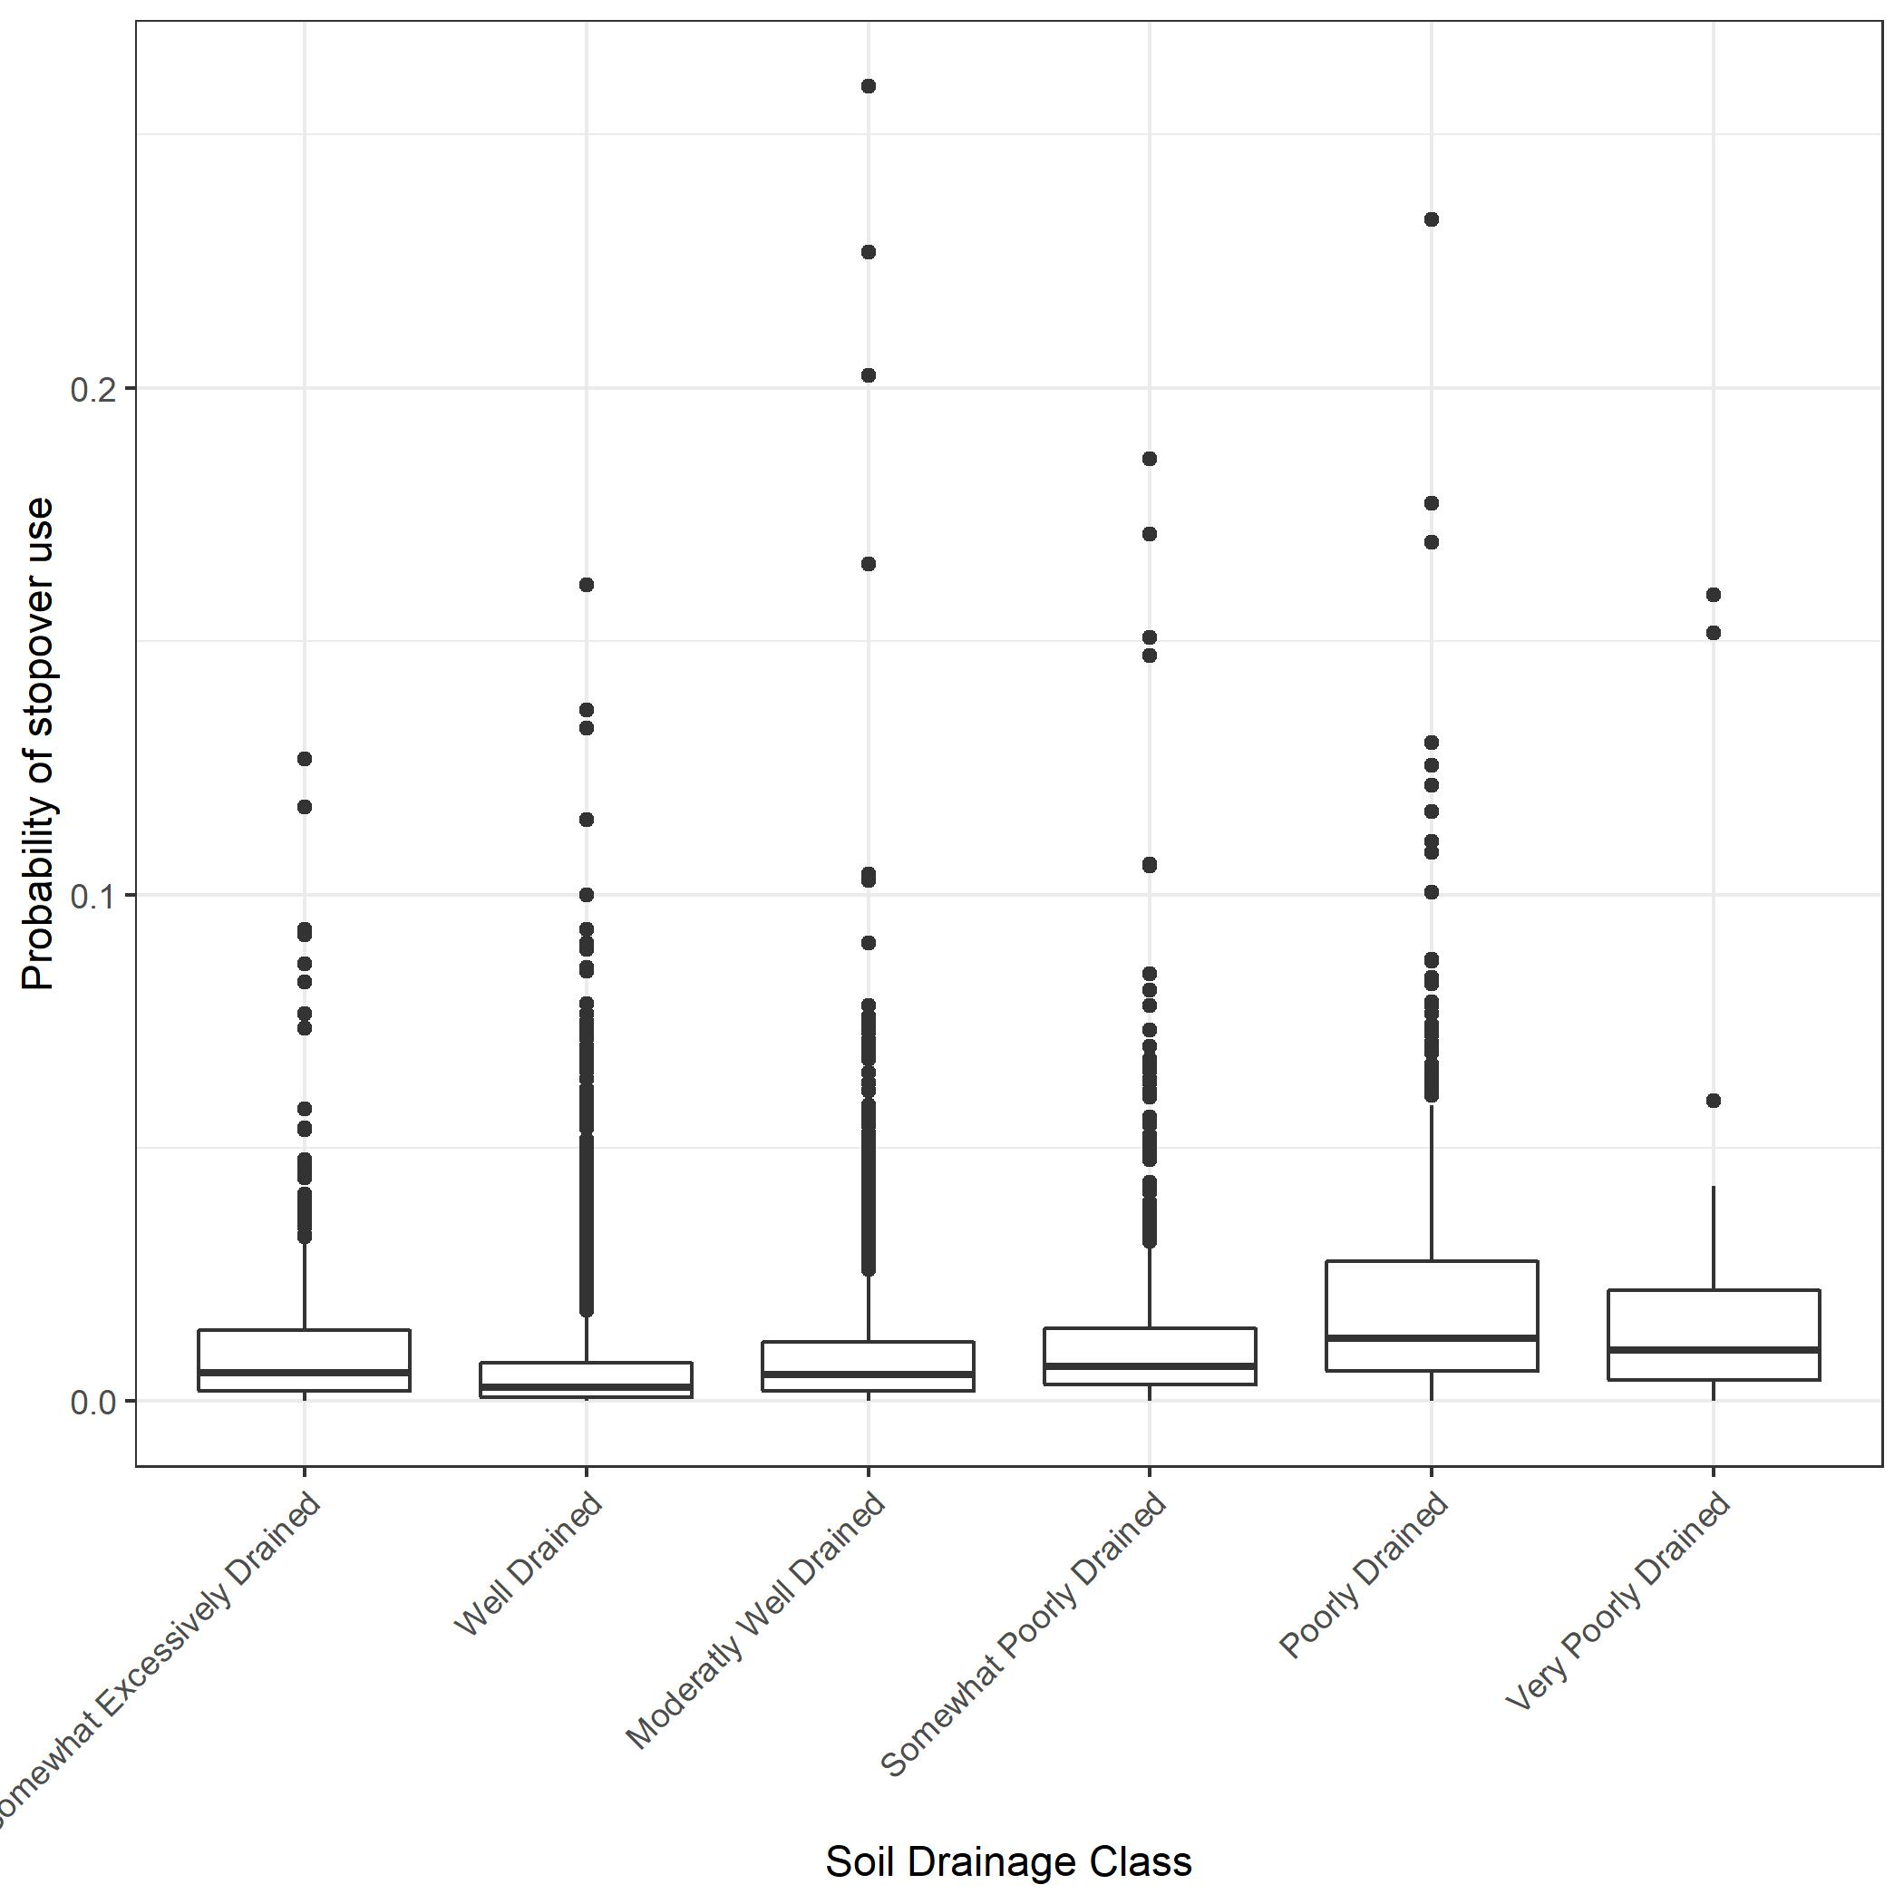
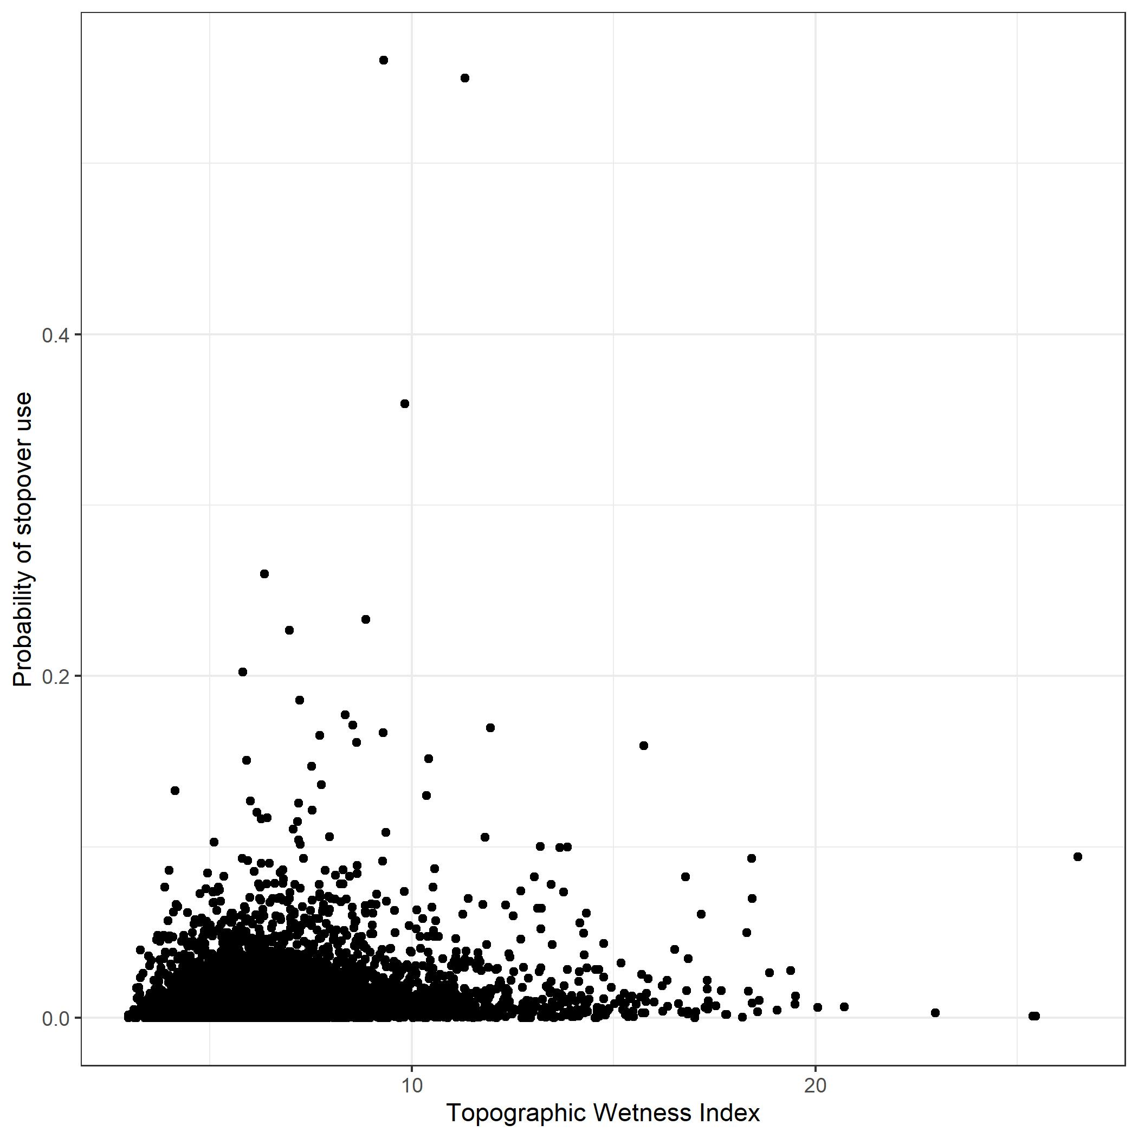

Slide 20
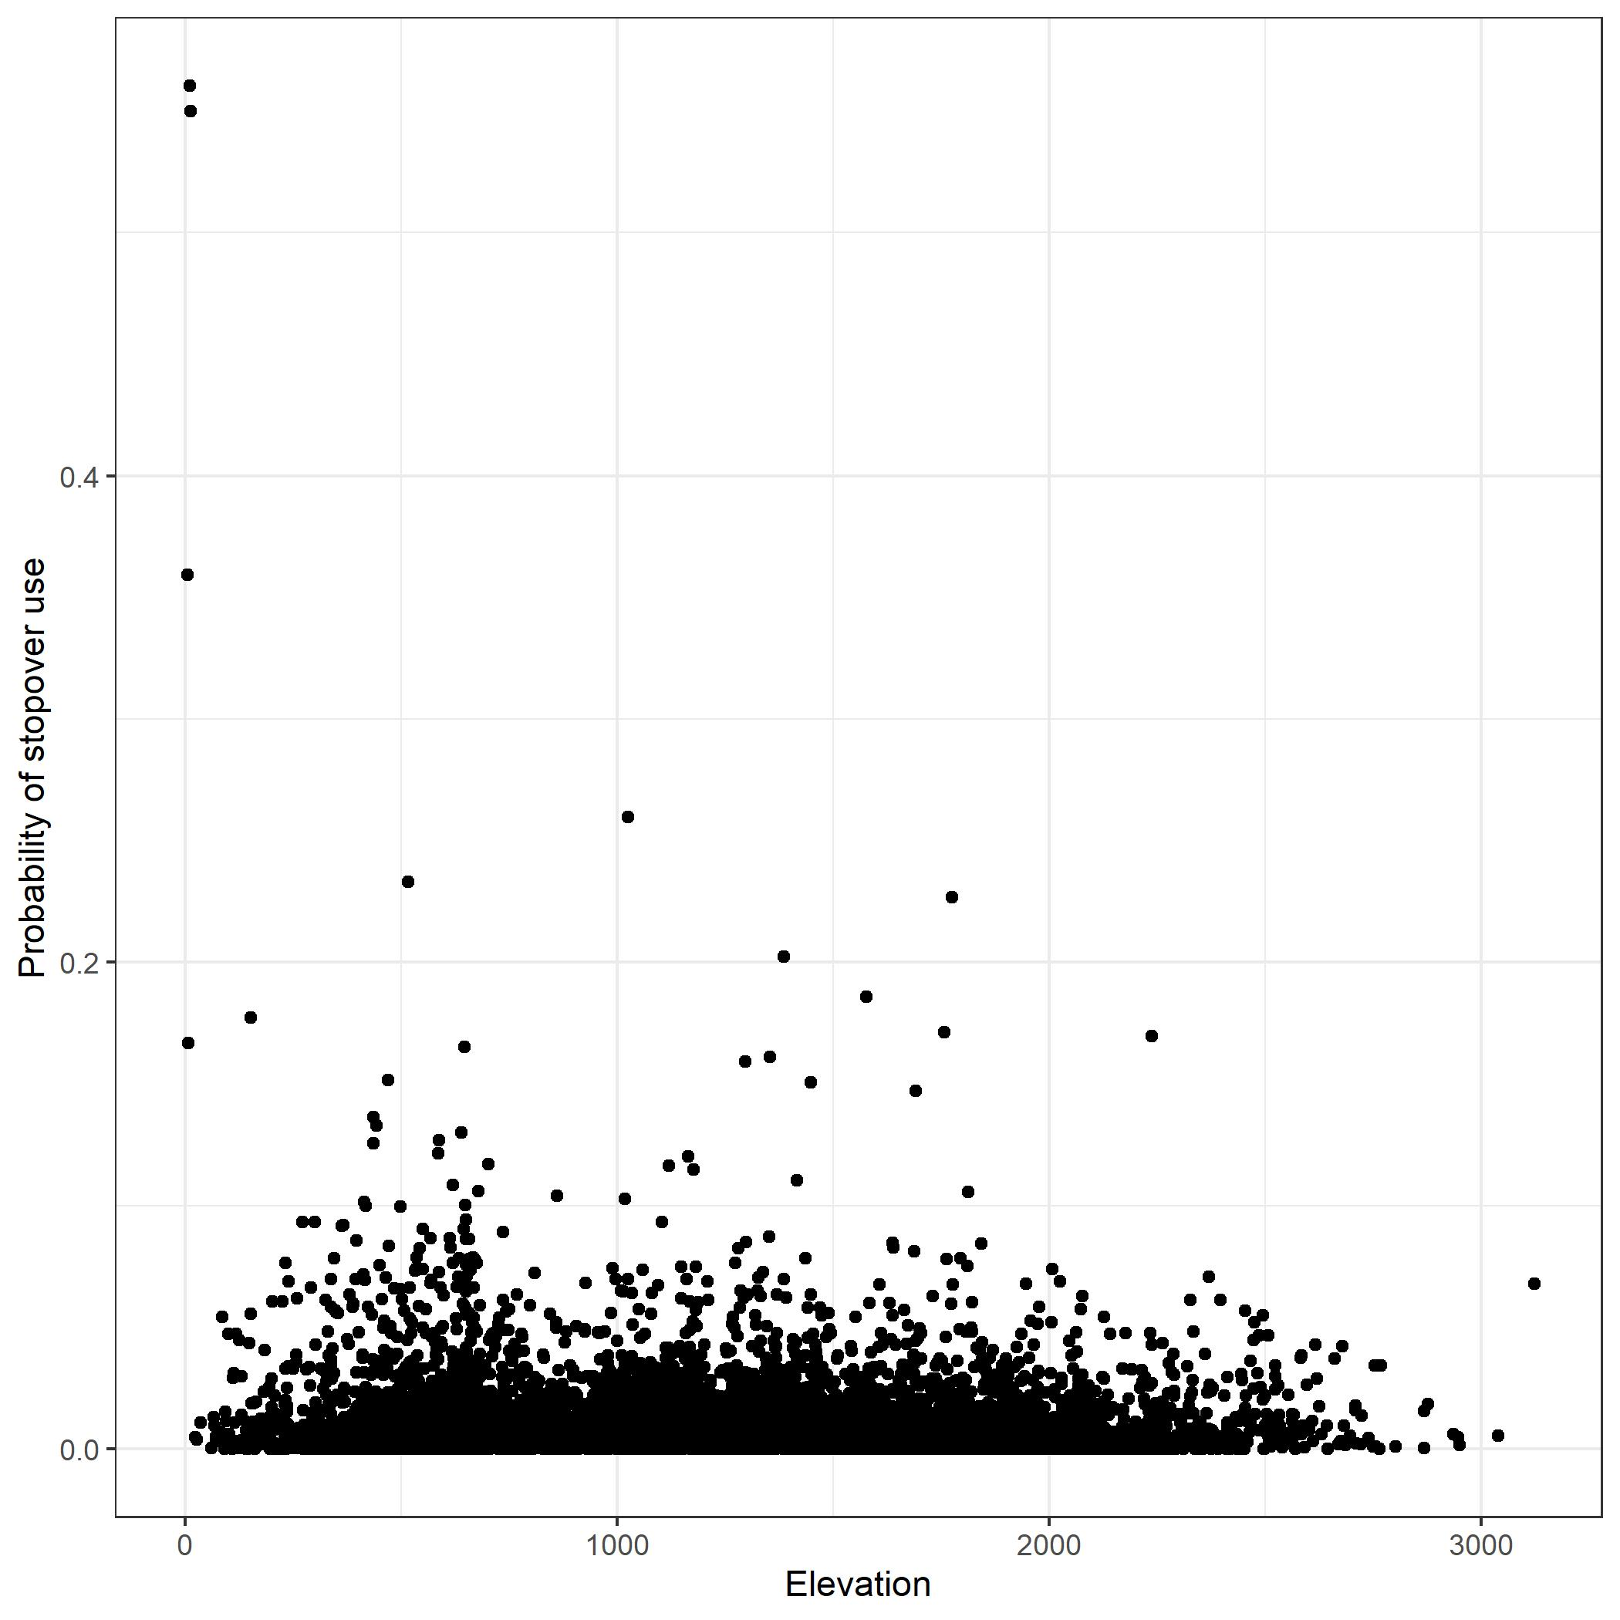
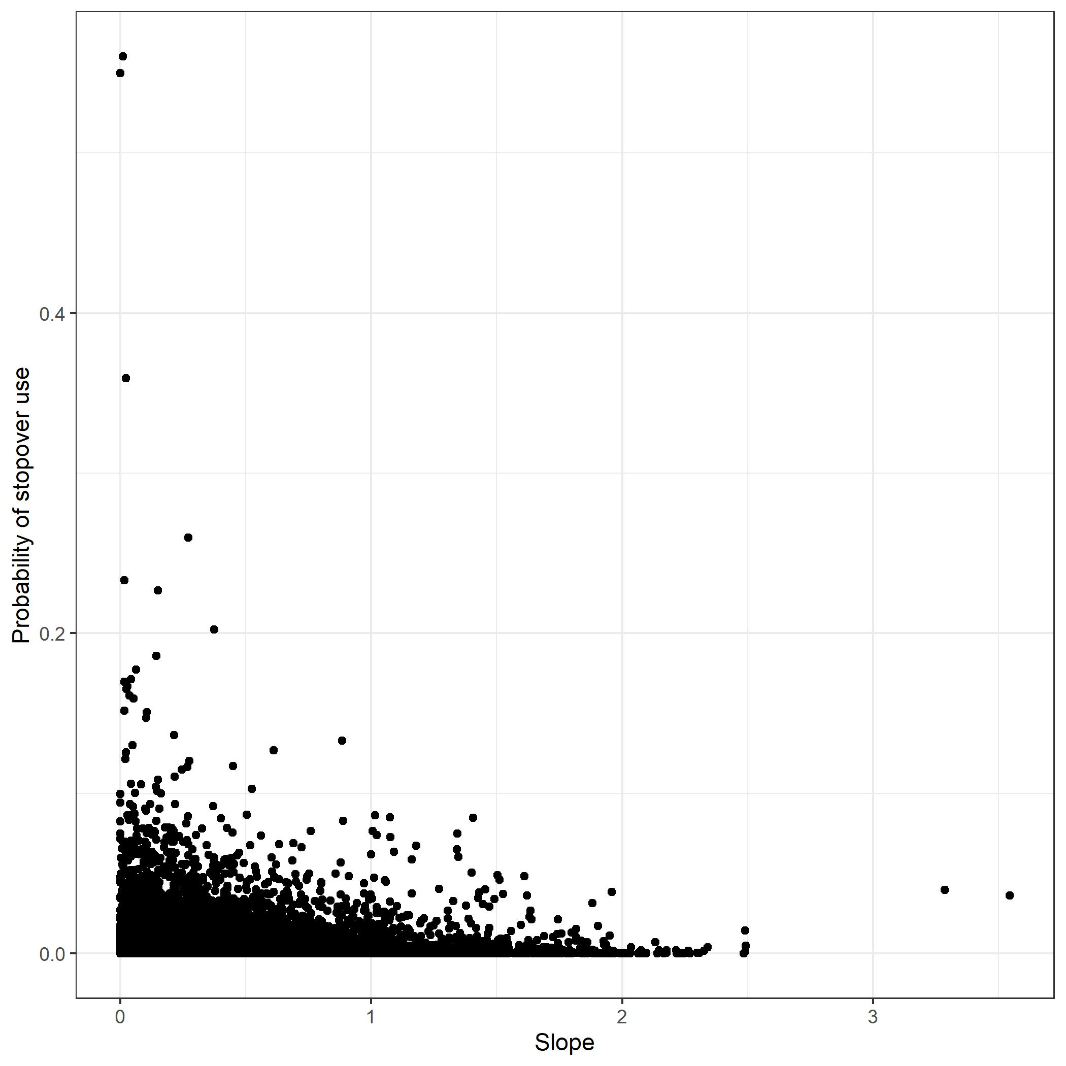
Slope and elevation

Slide 21
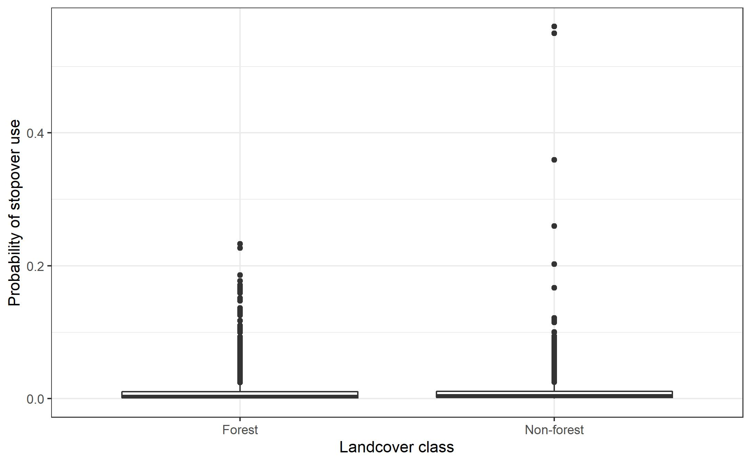
Forest vs. Non-forest

Slide 22
Plans for New Predictive Variables
Landscape | Moisture | Land cover | Topography
Aggregation index (5km) | Soil drainage class | Forest | Elevation
Cohesion (5km) | Topographic wetness index | Developed | Slope
Percent forest (5km) |  | Agriculture
Percent developed (5km)
Percent agriculture (5km)
Aggregation index (1km)
Cohesion (1km)
Percent forest (1km)
Percent developed (1km)
Percent agriculture (1km)

Slide 23
Modeling strategy
Build migratory corridor models to simulate availability of stopover habitat
Trial several modeling strategies, pick the one with the highest predictive capacity
Evaluate variable performance through jackknifing
Create a predictive surface using the best model

Slide 24
Predictive surface
Notes:
These words will be hidden, but I’ll transition to ArcPro here to show the woodcock predictive surface in an interactive display. I’ll be using this to show stopover trends by physiographic province and patterns of higher stopover propensity in eastern PA.
We’ll also look at state game lands with higher stopover propensity.

Slide 25
Finishing up the migratory model
Incorporating additional stopover locations from fall 2020 and spring 2021
Incorporating new and high-resolution variables
Completing the weighted migratory corridor model
Distribution
ArcGIS layer file
Web-accessible Shiny app

Slide 26
Next product: Residential model
The migratory model focused on selection of landscapes; this will focus on selection of habitat within each state game land
30m resolution versions of the datasets used in the migratory model
Some layers that are less useful at broad scales (e.g. moisture) may be relevant at this scale
State game land layers

Slide 27
For next meeting (tentative Apr 2021):
Goal: Have a draft product assembled for the residential model
Focusing primarily on finer scale habitat factors
3rd order habitat selection
Highlight where woodcock will go within the relevant state game lands

Slide 28


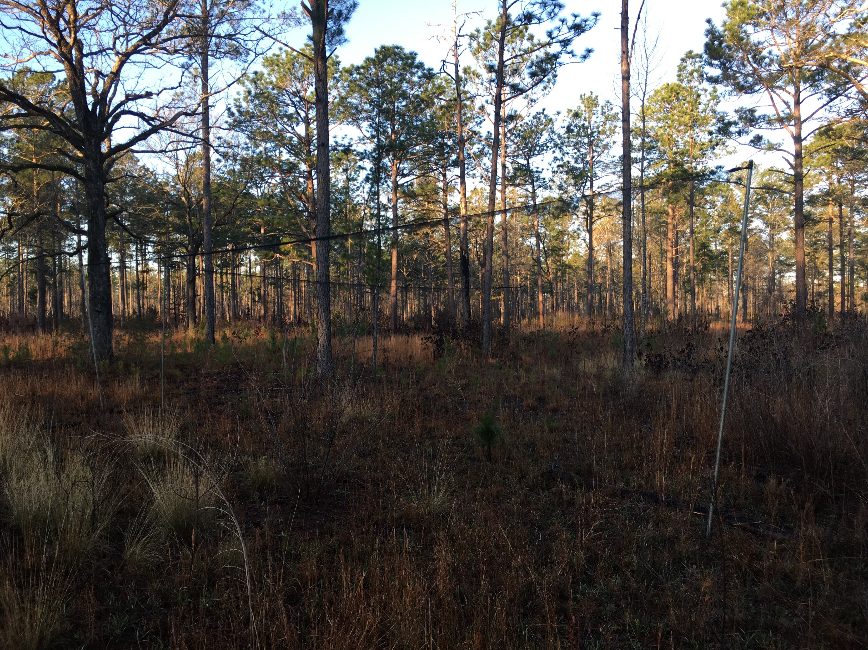
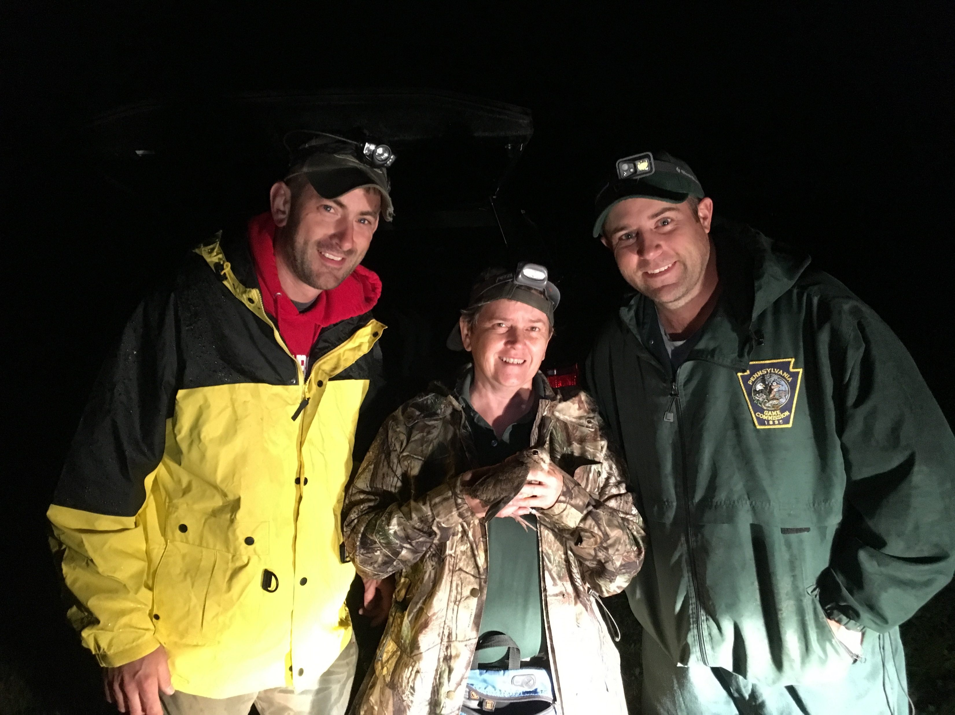
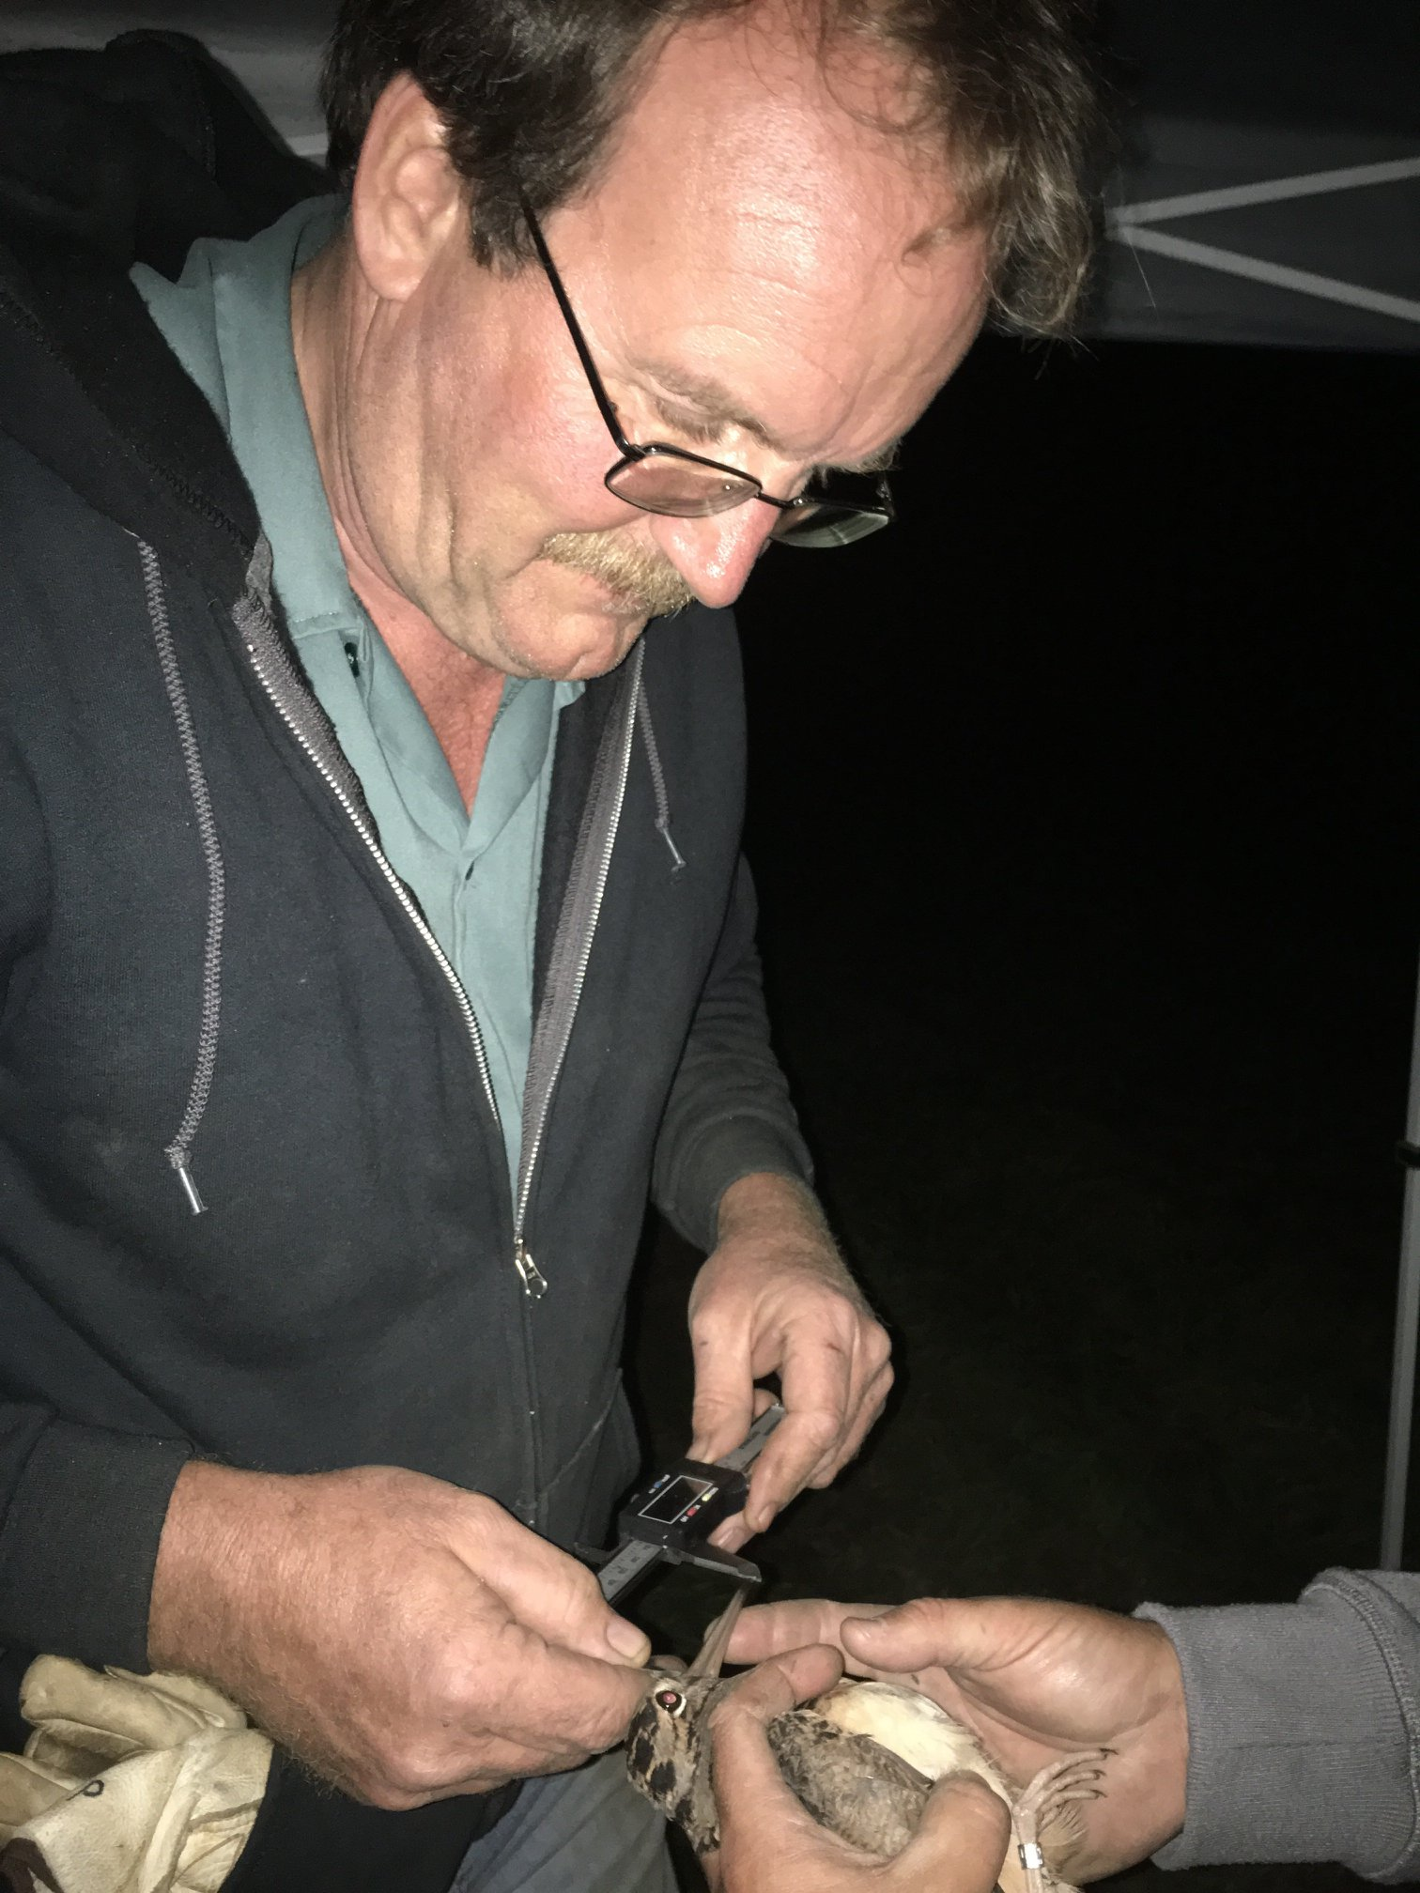
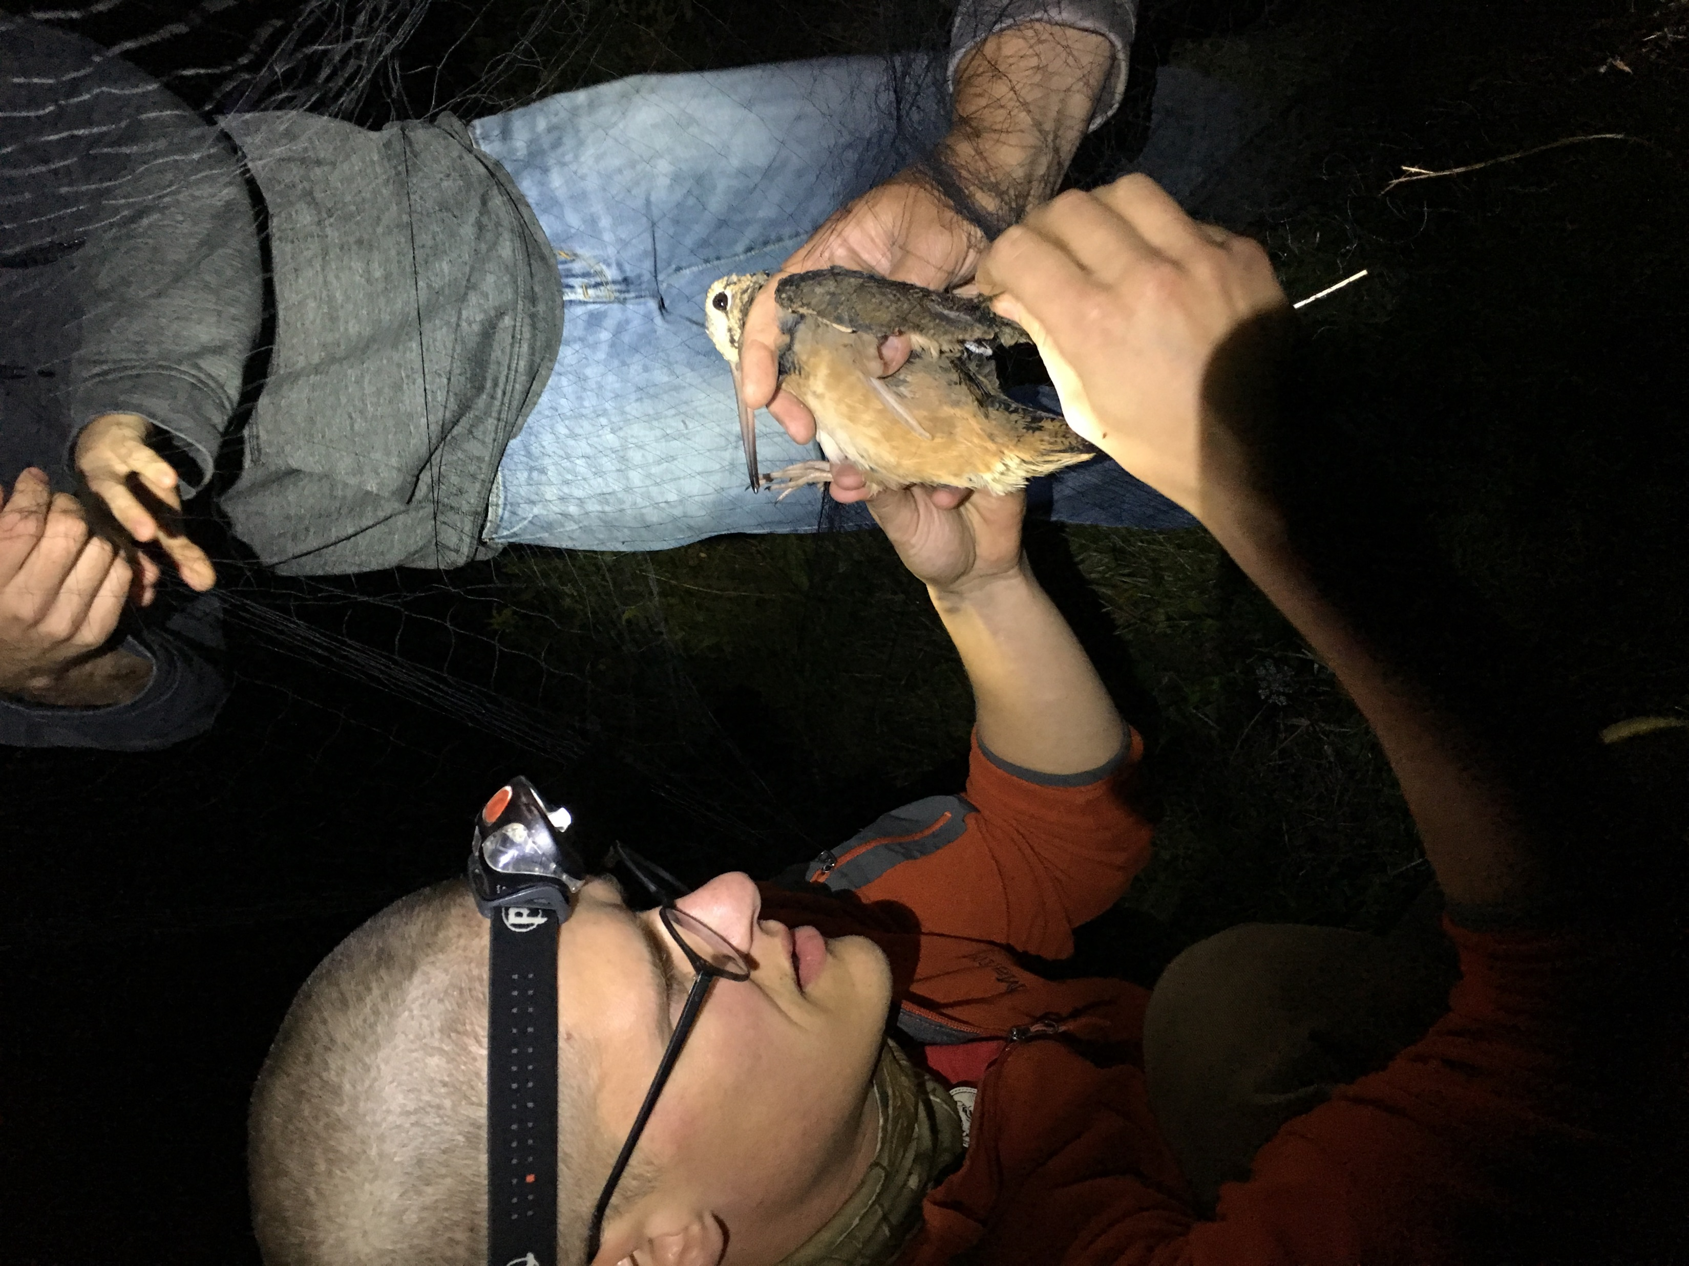
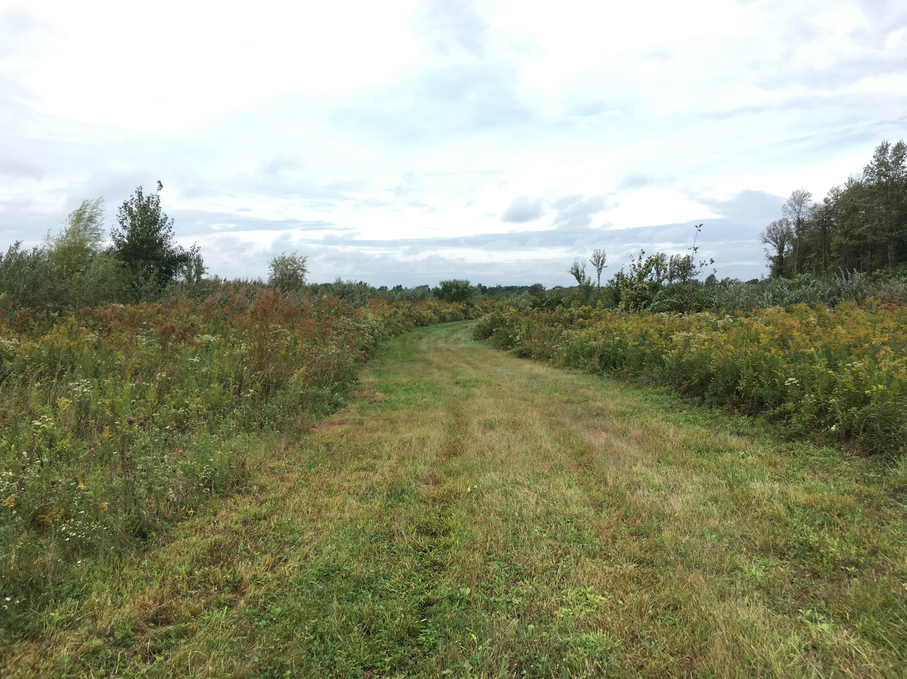
Thank you!

